Slide 1
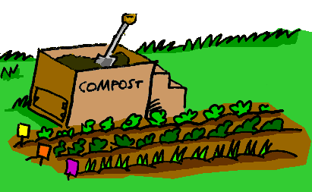
A Composting
Guide
ROBYN WEISNER

Slide 2
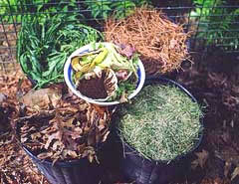
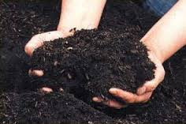


What Is Composting?
Composting is the breakdown of organic material.
Worms and bacteria are the primary decomposing organisms.
Result is a dark, nutrient-rich soil conditioner known as compost.
Notes:
Bullet 1: organic material = kitchen and yard waste like fruit and vegetable scraps, leaves and grass clippings
Bullet 2: also mention fungi and bugs like beetles and centipedes

Slide 3
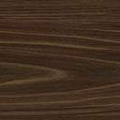
Why Compost?
Reduce the amount of organic waste destined for landfill sites.
Compost conditions soil and improves plant growth.
An easy way to return organic material to the soil.
Kitchen and yard wastes comprise over 30% of residential solid waste!

Slide 4
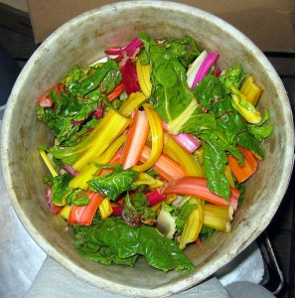
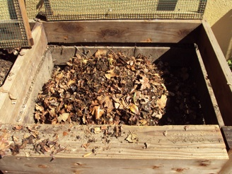
Materials for Composting
Green (Nitrogen-Rich)
Brown (Carbon-Rich)
Fresh grass clippings
Fruit and vegetable peels
Coffee grounds and tea leaves
Plant trimmings
Dry leaves
Cardboard
Small twigs and branches
Straw

Slide 5
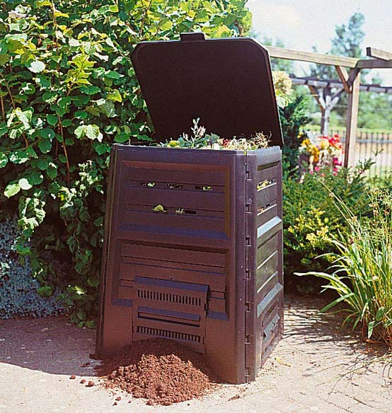
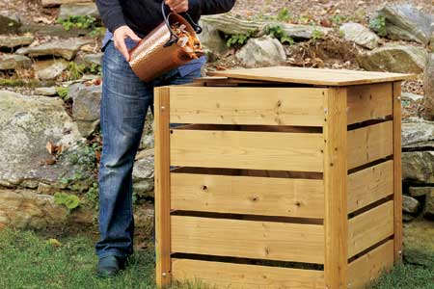
Compost Recipe
Compost Success!
Moisture
Air
Time
Brown & Green

Slide 6
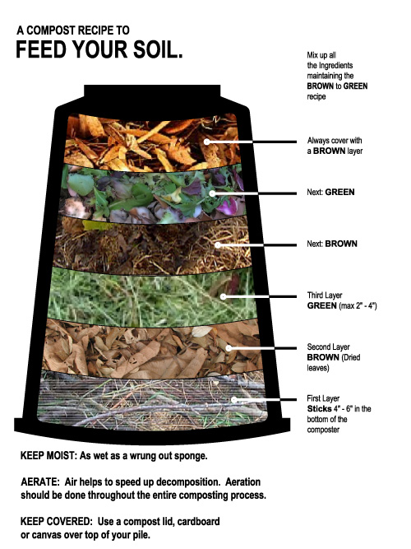
http://www.acrd.bc.ca/home-composting
How To Compost
Place kitchen and yard waste in rodent resistant compost bin.
Layer brown and green material.
Turn the material once a week.
In six months the bottom and centre of the pile should be ready to harvest.
Use the uncomposted materials to start a new batch.

Slide 7
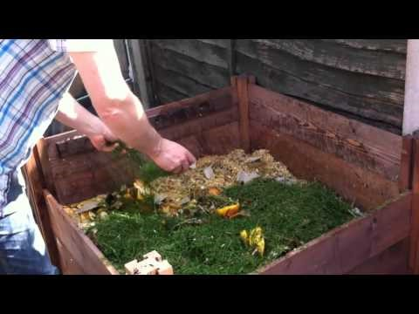
The Perfect Compost Recipe
How to get your compost heap cooking!
Video by growveg.com

Slide 8
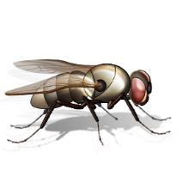
Common Compost Problems
Symptom | Problem | Solution
Bad odour | Not enough air; pile too wet | Turn it; add dry material
Pile is dry throughout | Not enough water, too much woody material | Turn it; add some water and fresh kitchen scraps
Pile is damp and sweet smelling, but will not heat up | Lack of nitrogen (green material) | Mix in fresh grass clippings
Pest infestation (rodents, insects) | Improper food scraps added | Don’t add meat, fats, or bones Use a rodent resistant bin
Flies | Food scraps not covered | Place fruit/vegetable scraps in center of pile; cover with brown material.

Slide 9
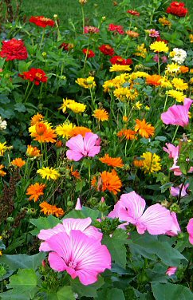
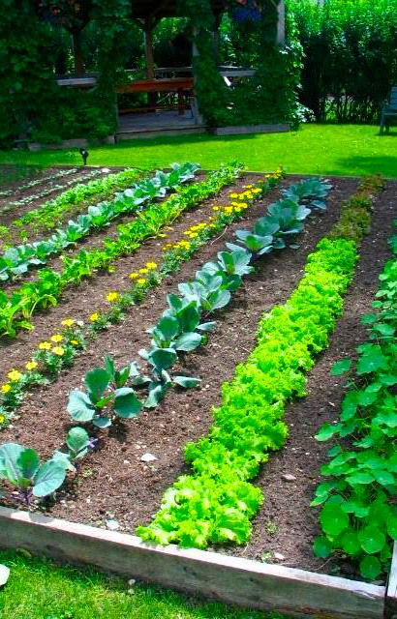

Use Your Compost
Mix finished compost into your vegetable and flower gardens.
The extra nutrients will fertilize your plants.

Slide 10
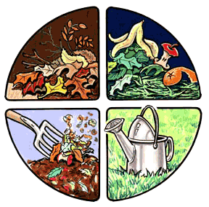
The End
For more information:

